Slide 1

Operating System Security (CYS337)
Data Recovery using Hiren’s BootCD PE | Recuva
By James Soko (20231392)

Slide 2
Hiren’s BootCD PE
Download Hirens BootCD PE and make it bootable in a USB Drive.
Shutdown and restart your PC into the Boot menu by pressing F12 repeatedly depending on your manufacturer.
Select the bootable USB drive e.g., UEFI: VendorCoProductCode 2.00, Partition
Wait for Hiren’s BootCD PE to initialize and load up.
Click on the Windows icon
Select All Programs
Select the Hard Disk Tools → Data Recovery Folder

Slide 3
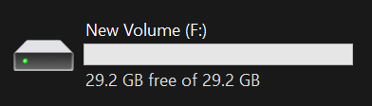
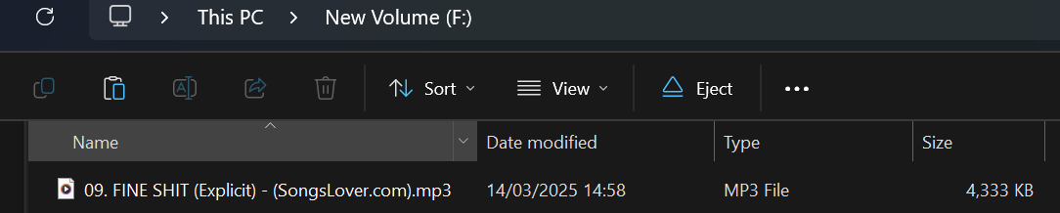
Deleting a Music File
Insert a USB Drive and format it.
Copy a music file to the USB Drive.
Delete the music file from the USB Drive.

Slide 4
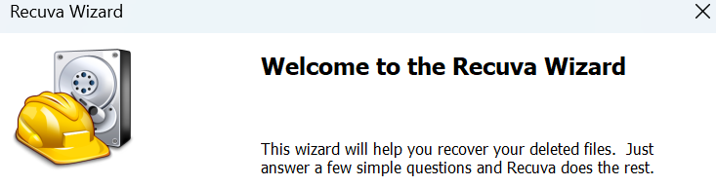


Configuring Recuva
Open Recuva.
Select our File Type as Music.
Select File Location: In a Specific Location.

Slide 5

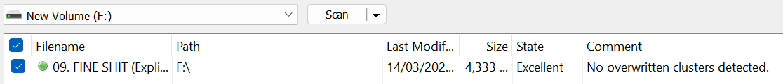

Recovering a Deleted Music File
Start the Scan and go to Advanced Mode.
Select the music file you want to recover.
Recover the music file and save it on another storage device.

